Slide 2
IFMC (iso-forward masking contour) task: count the number of probes you hear (1/2)
cue test
(easy to hear) (hard to hear)
f_{m1}
f_{m1}
+10 dB SL (both probes)
time →
masker probe
90
70
f_{p}
f_{p}
50
f_{m2}
30
f_{m2}
masker level (dB)
10
-10
variable frequency
100
1000
10000
masker frequency (Hz)

Slide 3
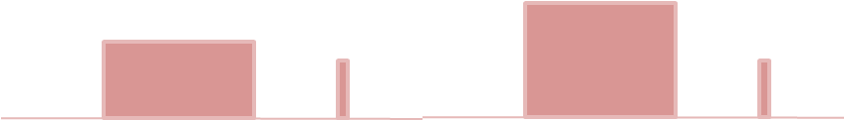
TMC (temporal masking curve) task: count the number of probes you hear (1/2)
cue test
(easy to hear) (hard to hear)
+10 dB SL (both probes)
time →
masker probe
masker dB
variable gap
0 gap 100ms

